Slide 1





Defaulter Tracking and Interruption To Treatment
Presenter: Beauty Dhliwayo, Forbes Clinic Site Lead
Chairing: Florence Mutevedzi
Date: 17 April 2023

Slide 2

CASE PRESENTATION
Mary Moyo(MM), 26 yr old Female Sex Worker, stays in Chikanga , Mutare
Divorcee with 2 children who stay with her parents at her rural home
Diagnosed HIV positive and initiated on ART 4 April 2022.
Commenced on Tenolam D and 3HP and was given 1month supply
She came back for review after 2weeks as scheduled and was commenced on CTZ.
She then came back 2weeks later for ART resupply and 2 months supply was given.
A reminder was sent a 3 days before her scheduled visit but unfortunately, she did not turn up.
A call was made but her phone was not reachable which prompted a home visit however she was nowhere to be found.
WHAT COULD HAVE BEEN DONE TO PREVENT IIT IN THIS PATIENT ??

Slide 3
Literature Review
An estimated 37.7 million (30.2–45.1 million) people were living with the human immunodeficiency virus (HIV) at the end of 2020. About 5000 new HIV infections are reported on a daily basis globally, 61% of which occur in sub-Saharan Africa (SSA).
Antiretroviral therapy (ART) increases life expectancy: a 2017 meta-analysis reported that starting ART at age 20 years increases life expectancy by an additional 22.9 years .
Despite this benefit, uptake and persistence have been suboptimal in LMIC. Of the ±20.6 million people living with HIV (PLWHIV) in Eastern and Southern Africa, only 78% were accessing ART in 2020. Without innovative interventions, these regions will struggle to attain the United Nations Program on HIV/AIDS (UNAIDS) 95 95 95 goals by 2030.
Specifically, the second goal of having all people diagnosed with HIV infection on sustained ART remains an obstacle in SSA. A 2007 systematic review reported that fewer than two-thirds of PLWHIV in SSA remained on treatment 2 years after ART initiation
This is supported by more recent studies, which have shown that only 70%, 65%, and 63% of people remained on treatment after 2, 3, and 6 years of ART, respectively.

Slide 4

Literature Review
The high rates of patients Lost To Follow-Up (LTFU) at each stage of the HIV care cascade make it difficult to achieve higher standards of care across health systems. Unfortunately, the most vulnerable step along the care cascade is long-term adherence.
ART has the potential to dramatically reduce morbidity and mortality for PLHIV, however incomplete treatment adherence is the major cause of treatment failure, development of drug resistance, HIV disease progression, and death .
Systematic reviews have demonstrated that long-term adherence to treatment in Sub-Saharan Africa is of particular concern, as one-third of adults in the region lose viral suppression at two years of treatment.
Treatment as prevention also depends on retaining HIV-infected patients in care.

Slide 5
Operational definitions
Retention is defined as a situation whereby a patient has a attended healthcare clinic within 28 days of their last scheduled appointment for medicine collect on, laboratory testing, and/or clinical review and is not documented as having died, or stopped treatment or as lost to follow-up. Patients with documented transfers to other facilities should be tracked for retention at that facility
A patient is classified as on time when they arrive on the exact date of their expected appointment
A patient is classified as having a kept appointment when they arrive 7 days before or 2 days after their expected appointment
A patient is classified as having a missed appointment if they are equal to or more than 3 days, but less than or equal to 4 days, late for their expected appointment.
A patient is classified as a defaulter if they are more than 4 days, but less than or equal to 28 days, late for their expected appointment.
A patient is classified as Interruption in Treatment (IIT) OR lost to follow-up (LTFU) if they have not been to any HIV care center for more than 28 days since their last appointment date.

Slide 6
Tracking outcomes
Tracking outcome: This is the immediate result (finding) from a tracking activity. Possible outcomes include: Not Reached, Self-transferred, Known Death or Stopped Treatment,
  Not Reached: Client could not be contacted on phone or by visiting him/her. This may be as a result of a wrong address or phone number or change in the registered address or phone number without notifying the health facility.
  Self-Transfer: Pre-ART or ART client reported to be receiving care and treatment in another health care facility without documented evidence of a formal transfer from the previous facility.
  Known Death: Pre-ART or ART client reported to have died. This information may be offered by a family member, friend, treatment supporter or neighbour during tracking.
  Stopped Treatment: An ART client who stopped taking ARVs (therapy) for medical or social reasons, with or without consultation with the clinician
Notes:
PrEP is one of the new HIV Prevention strategies recommended in the WHO HIV management Guidelines(2015).
PrEP is taken in combination with other HIV prevention strategies to reduce the risk of acquiring HIV by HIV negative people.

Slide 7
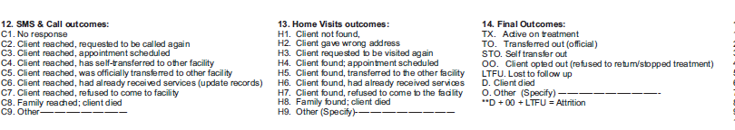
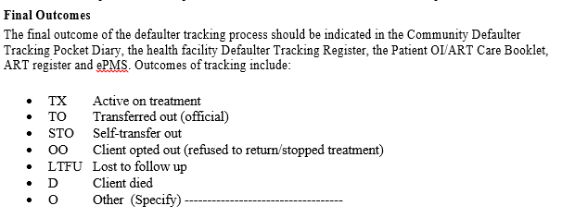
Defaulter tracking outcome

Slide 8
Categories of KPs to Track
Pre-ART clients enrolled in care (adult and children) who default.
ART clients (adult and children) who default drug refill and clinic appointment.
Routine Viral Load- clients due for routine VL sample to be collected
High VL result collection
EAC – clients due to the clinic for EAC session
Those on PrEP who have missed their visit while still at risk
New HIV positive clients who did not visit the facility as per referral.
Notes:
This is a diagramatic representation of the combination prevention
NB. PMTCT, screening of blood, harm reduction, universal precautions have not been included
The focus is reducing sexual transmission of HIV

Slide 9
Engagement of OW and other CBHWs
As CeSHHAR we have Outreach workers and Microplanners that work within communities and their corresponding health facilities serving their catchment areas.
The Microplanners and outreach workers play similar roles to the MOHCC community cadres ---- Outreach Workers and and CATs
An inventory of all outreach workers and microplanners is be kept by the Site Leads and efforts should be made to periodically assess functionality of these cadres in community level work.
This inventory should include capacity building needs of outreach workers in line with current national guidelines for the various programs that facilities will be implementing.

Slide 10
Patient Identification at Health Facilities
At each review date a client is documented in an appointment diary:
  Clients should be documented against the date when they are next due for review;
  Client’s full name, physical address and phone number including secondary ones are also documented.
The facility healthcare workers make use of the appointment diary on every clinic day:
  Clients who came to the facility on their appointment dates are marked to differentiate them from those who failed to turn up.
  At the end of the week, a list of all clients who failed to turn up on their appointment date and within seven days of this date is prepared
  The list should have clients’ physical address, telephone number where applicable and the name of next of kin and contact details

Slide 11

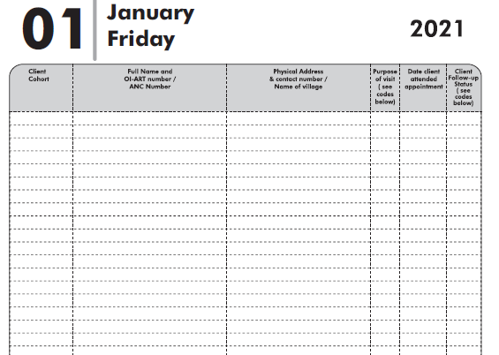
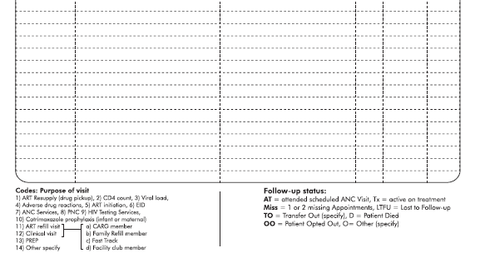

Slide 12
Communication between Facility and Community Health Workers
On the last day of every week (ideally Friday), an outreach worker/Village Health Worker/ Microplanner should communicate with facility-level health workers.
Facility based Health Workers should:
  Develop a list of defaulters and start the defaulter tracking
  Communication between facility health workers and community health workers should be continuous throughout the month to ensure timely and continuous tracking of clients.

Slide 13
Patient tracking in the community
Outreach workers /Microplanners should use the list of defaulters from the facilities to conduct follow-up of all clients who have been considered to be defaulters.
Outreach workers/ Outreach Lead should ensure that:
  All clients that are to be followed up are documented in the patient tracing register
The referral slip includes the reasons for referral and the following processes should be followed:
  Upon arrival at the health facility, the referred client should hand over the referral slip to the nurse, who in turn should complete and put it in the referral box. %
  Facility nurse should update all relevant registers and clearly indicate in the appointment register that the client has reported to the health facility including date seen.

Slide 14
Patient tracking in the community
At the end of each week the outreach worker will file at the facility the referral slip and handover the tear-off section of the referral slip to the NT supporting the facility.
When the tear-off section of the slip is handed over to the NT, that tracking is recorded as complete in the patient tracking register (held by Outreach worker) and complete referral in the referral register (held by Nurse).
All followed up clients are provided with health education and counselling on the importance of adherence to treatment by the outreach workers.
Tracking and tracing of clients should continue for 28 days from the scheduled clinic appointment date before a patient is declared lost to follow up.
Outreach workers should document the outcome in the patient tracking registers and update the NT if the client is declared LTFU.

Slide 15
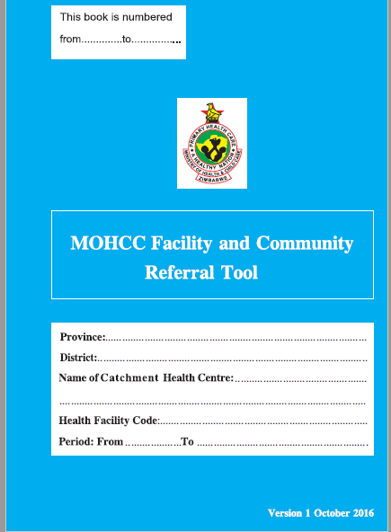

Slide 16
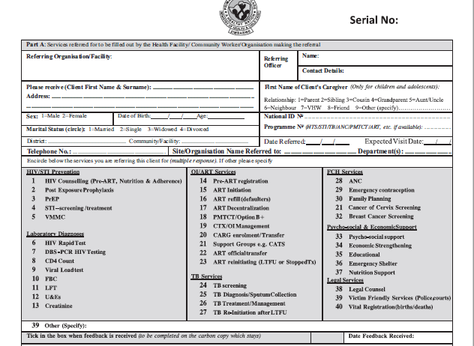

Slide 17
DEFAULTER TRACKING SOP
At enrolment, KPs should be asked if they agree to consent to tracing. Their decision should be clearly indicated in the green book page 2.
All sites should have an appointment system for HIV positive SWs.
The Site Manager must be clear which staff member (nurse, Outreach worker) is responsible for updating the diary on a daily basis and for initiating the defaulter tracing process.
All KPs initiated on ART should be given an appointment date, which is recorded appointment on a diary. If group club refills are implemented, the group number should be recorded in the appointment diary and a booked time for the group allocated
The OI number, KP’s name, telephone number and the reason for the next appointment (clinical consultation +/- counselling, refill for drugs, blood draw for VL) should be listed in the diary.

Slide 18
Defaulter Tracking SOP
The diary list can be used to pull the patient care and treatment booklets the day before and also to pre-pack refills in larger sites.
When the client arrives, it should be marked off in the diary that they have attended.
At each visit, whoever is registering the client should check that an up-to-date phone number is available and is documented in the appointment diary
If the client does not attend for their appointment, their patient care and treatment booklet should be kept aside in a tray or shelf allocated for late-attenders. Tracing is not triggered immediately and patients’ files coming 1-3 days late should be found in this tray.
If the client has not attended for three days, the client should be traced. All clients, when first registered, should give consent to be traced.
If just phone tracing is required, this may be done by the nurse or outreach worker; if phone or home visit is required, this is done by a nurse or outreach worker.
Files for patients being traced should be placed in a “tracing” tray.

Slide 19
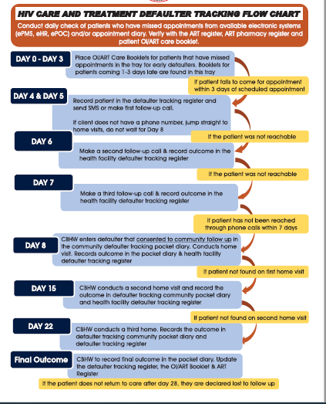

Slide 20
Defaulter tracking cascade
Still in care
91% (286/313) are still in care at the same facility
3 Official transfer
24 are self transfers
73%
True defaulters = Returned to care + IIT (LTFU) + Refused/Stopped treatment

Slide 21
Defaulter tracking cascade
Returned to care
42% (5/12) were returned to care at the facility
42%
True defaulters = Returned to care + IIT (LTFU) + Refused/Stopped treatment

Slide 23
District Tx_ Curr Analysis – 31 March 2023
 | Forbes | Mutare | Total
TX_CURR as @ 31 Dec 2022 | 55 | 49 | 104
Died | 0 | 0 | 0
Previously Undocumented Patient Transfer (Self Transfer) | 1 | 0 | 1
Official Transfer | 0 | 0 | 0
Transitioned to public sector | 5 | 16 | 44
Interruption in Tx After being on Treatment for <3months | 8 | 9 | 17
Interruption in Tx After being on Treatment for 3-5months | 0 | 0 | 0
Interruption in Tx After being on Treatment for 6+months | 0 | 0 | 0
Did not attempt to Trace Client | 0 | 0 | 0
Stopped (Self or Medical reasons) | 0 | 0 | 0
TX_RTT experienced IIT <3 months before returning to treatment | 0 | 2 | 2
TX_RTT experienced IIT 3-5 months before returning to treatment | 0 | 2 | 2
TX_RTT experienced IIT 6+ months before returning to treatment | 0 | 0 | 0
Transfer In | 0 | 0 | 0
TX_New Jan-March 2023 | 22 | 31 | 53
Reported TX_CURR as @ 31 March 2023 | 63 | 59 | 122

Slide 24
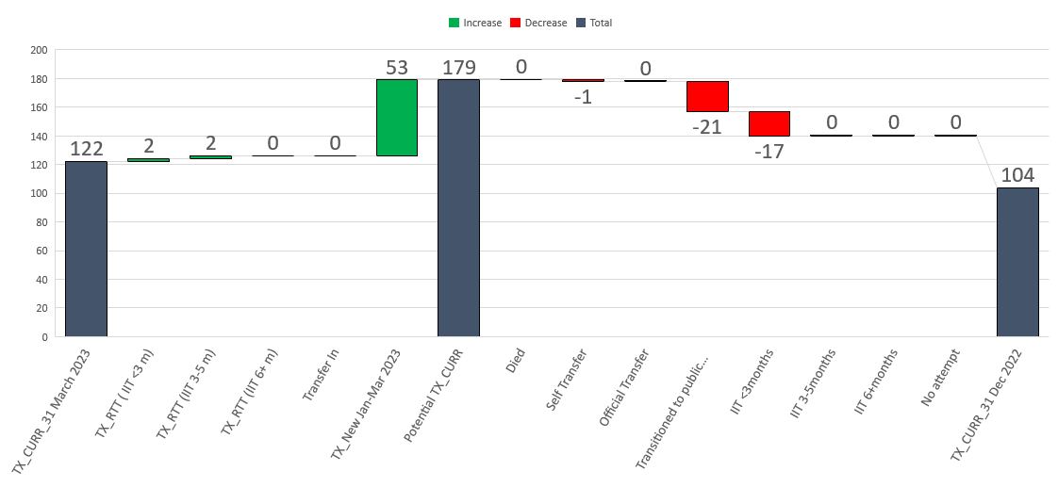
Tx_ Curr Waterfall Analysis for Mutare – 31 March 2023

Slide 25
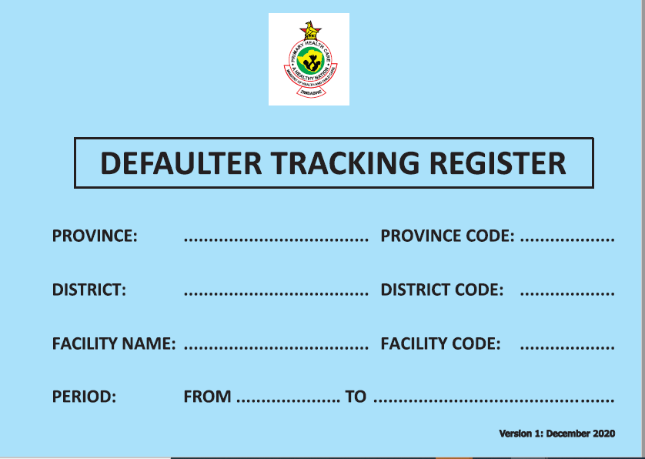

Slide 26
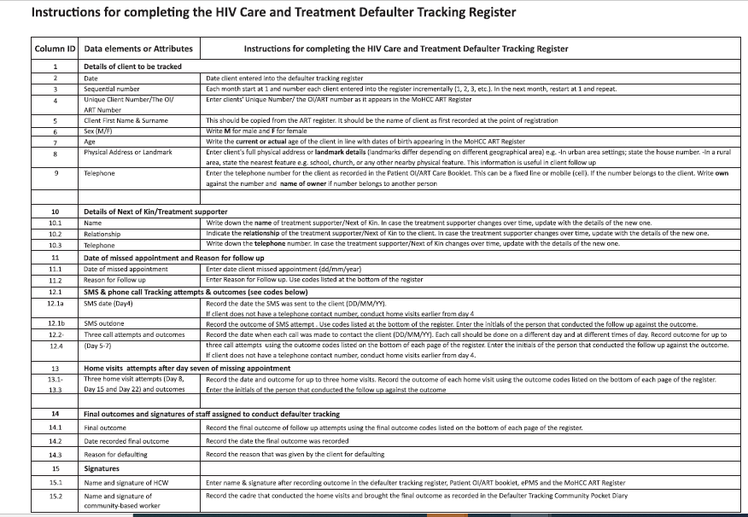

Slide 27
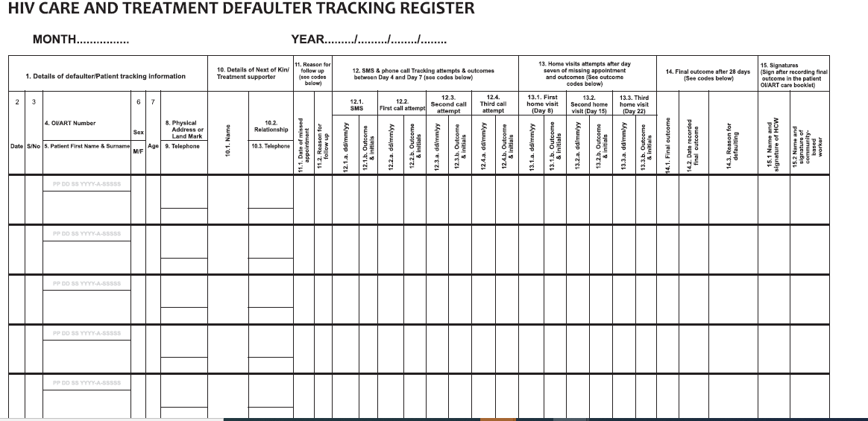
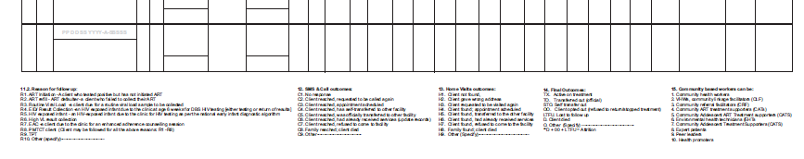

Slide 28
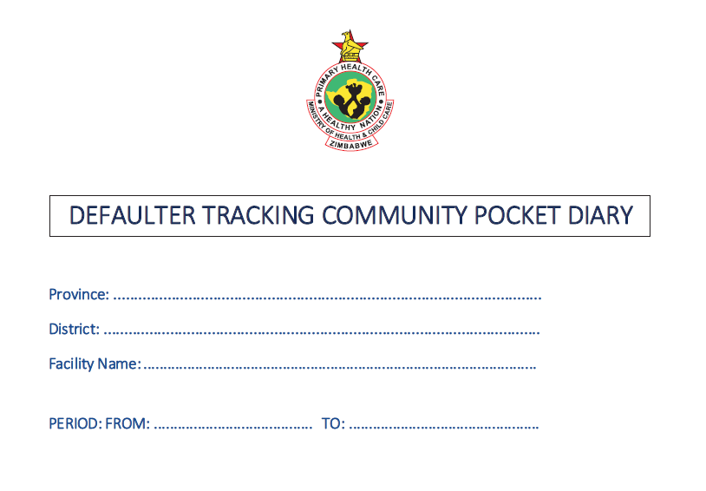

Slide 29
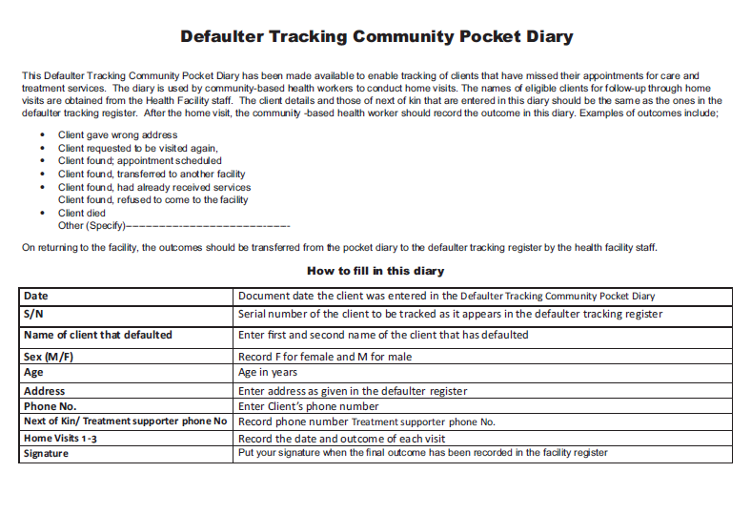

Slide 30
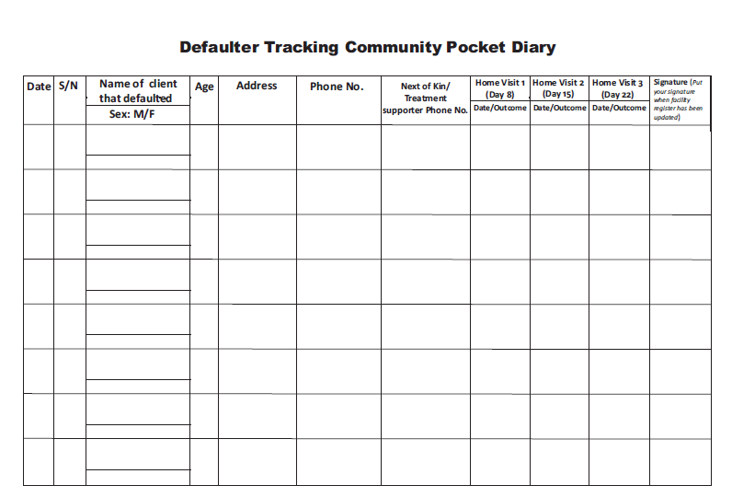

Slide 31
TX_ML Definition
Number of ART patients (who were on ART at the beginning of the quarterly reporting period or initiated on treatment during the reporting period) and then had no clinical contact since their last expected contact
TX_ML (treatment mortality and loss) is intended to:
  (1) help better understand fluctuations or steady growth in TX_CURR over time,
  (2) encourage tracing of patients when a patient has had no clinical contact for greater than 28 days since their last expected contact and
  (3) promote timely identification of patient outcomes among patients known to have missed clinical visits or drug pickups.

Slide 32
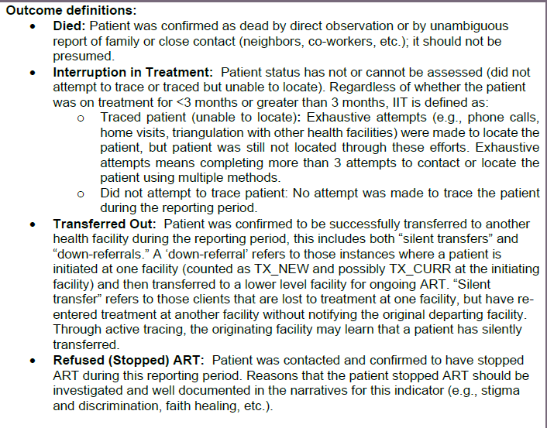
TX_ML OUTCOMES

Slide 33
TX_RTT Indicator
These are individuals who were previously on ART who restarted ARV after being off treatment for more than 28 days (and therefore experienced as IIT) .
Number of ART patients who experienced IIT during any previous reporting period who successfully restarted ARVs within the reporting period and remained on treatment until the end of the reporting period
Changed language of LTFU to patient centred language of Interruption in treatment (IIT)
Used as index cases also

Slide 34
Overview of data collection & reporting processes
Indicator |  | Primary Data Source/s | Data collection tools and SOPs | Frequency of data collection | Frequency of DQA activities
TX_CURR |  | Patient OI-ART Booklet EPMS Patient Tracking & Tracing Register Essential Changes Register Missed appointment list | - Monthly Return Form (MRF) | - Monthly | - Monthly Desk reviews Physical Count (Targeted and stratified by volume) Low volume facilities (physical count every 2 months) Medium [600-1500] (physical count every quarter) High volume facilities (Physical count once every 4 to 6 months) In between and as complementary, the Essential Changes Register is used to adjust suing Essential Changes Register in between) Onsite Data Verification Exercises Quarterly DQA at random sampled sites.
 |  | Patient OI-ART Booklet Essential Changes Register EPMS Defaulter Tracking Register Missed appointment list | Monthly Return Form (MRF) TX_CURR Tracker QUASI-MRF | - Monthly
TX_NEW |  | ART Register EPMS Patient OI-ART Booklet | Monthly Return Form (MRF) QUASI MRF | - Monthly | - Monthly Desk reviews & Onsite Data Verification Exercises mainly targeting sites with low ART Linkage.
TX_ML |  | Patient Tracking & Tracing Register Missed Appointments Essential Changes Register EPMS | Monthly Return Form (MRF) QUASI MRF | - Monthly | - Monthly Desk reviews & Onsite Data Verification Exercises mainly targeting sites reporting high LTFU.
TX_RTT |  | Patient Tracking & Tracing Register EPMS Essential Changes Register | - QUASI MRF | - Monthly | - Monthly
TX_PVLS |  | OI-ART Patient Care Booklet Improvised Viral load Register LMS data | QUASI MRF Excel Viral Load Dat³a | - Quarterly | - Quarterly Desk Reviews & Onsite Data Verification Exercises

Slide 35
 | Retention Indicators Challenges and Recommendations
es Indicator | Challenges | ns Proposed Solutions
 | - Arithmetic errors have been observed when recalculating TX_CURR data reported. | Provide a TX_CURR tracker to support monthly calculation of TX_CURR. EHR rollout
TX_CURR
 | Inconsistent updating of clients Patient booklets & EPMS records resulting in reporting false LTFU Use of paper-based system is cumbersome to tracing and determining outcomes clients LTFU | Routine Register Completion Audits Routine Data Quality Assessments to determine “TRUE” Active clients on ART. EHR rollout
TX_NEW | - No challenges observed, this indicator has a definite source document and has been reported through the standard MOHCC reporting system for many years.
TX_ML | Incompleteness of Essential Changes Register Use of paper-based system is cumbersome to tracing and determining outcomes clients LTFU | Routine Register Completion Audits Electronic Patient Management Systems at all health facilities.
TX_RTT | - Occasional under reporting of TX_RTT because LTFU clients for 28-29 days who may be returned to care are silently added back to TX_CURR. | - Regular OSDVs and mentorship
TX_PVLS | Now there is the register to record and summarise data for this indicator but not used for EAC. For health facilities without an electronic patient management system, the process of collecting data quarterly for the annual period is cumbersome. Further, in these health facilities the risk of double counting clients is not improbable. 11 | Data Triangulation Using LMIS. Line listing clients with high viral load tests and retests to avoid double reporting.

Slide 36
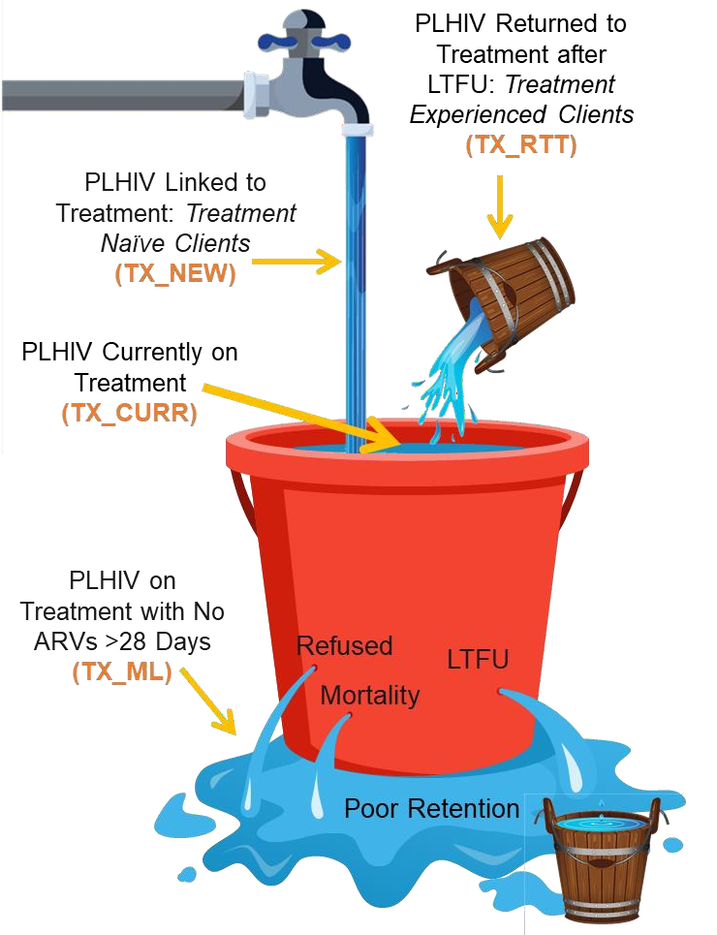
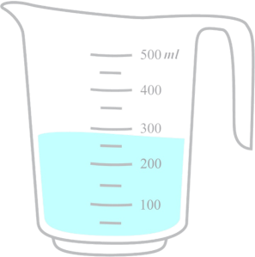
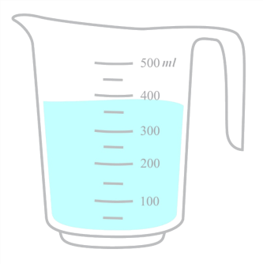
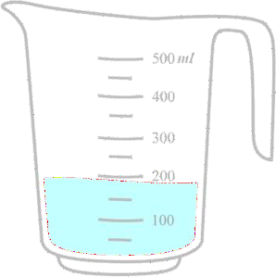
MER Indicators Used to Understand Retention
Change in Number of PLHIV Currently on Treatment
(TX_NET_NEW)
By how much did the volume of our bucket change from one time point to another?
Most recent additions to MER are included to help us better understand treatment program growth (TX_NET_NEW) to
accelerate attainment of the 95-95-95 goals
Net gain
Net loss
25

Slide 37
DSD TX_NET_NEW Waterfall Analysis (Q3-Q4)

Slide 38
Progress of the presented Case
MM was tracked through the community cadres on Chikanga
She was reported to have relocated to Chiredzi where stays with her parents
Transfer out was made to Chiredzi , Tsvovhani Clinic .

Slide 39
Level | Challenge | Recommendations
SW care level | Giving wrong addresses Wrong phone numbers or even names Stigma and non disclosure | Ensure all patients give detailed phone and home contact information and a treatment buddie or trusted family member name and contact information for future contact Confirm a phone number when it is shared and at every visit Service providers should have many services they are offering as they do home visits
Facility/Programming challenges | Shortage of fuel, staff and vehicles to do home visits | Consistent availability of fuel ,Locum nurses and more vehicles at sites
Strategic Information | No Defaulter tracking Cascade at facility and regional Level | Include a defaulter tracking cascade at subnational level
Provider level | Phones not reachable | Stagger calls at different times of day and on different days, and evenings and weekends if possible, to maximize chances of reaching patient
Policy Level | Clients who self transfer and cannot be identified if they receive medicines from other facilities | A functional electronic health record system at national level e.g E HR or EPMs at all sites nationally

Slide 40
Best Practices
Diligent use of the Appointment Diary , Defaulter tracking register and Pocket Diary to help identify and document treatment interruptions
Community Cadres (Outreach Workers and Microplanners support in follow up of patients who interrupt treatment
Collaboration with ZHI cadres who have motorcycles that are seconded to clinics and mainly focus on defaulter tracking in the community.

Slide 41

WAY FORWARD
How best can we address our challenges
How can we adopt and scale up best practices

Slide 42
Conclusion
Successful tracking and tracing of PLHIV who have failed to return to care/treatment will allow targeted interventions to help return those patients back to treatment, document their treatment in another setting, or document their death or loss to follow up (LTFU).
Identifying and locating PLHIV who fail to be retained in care/on treatment are important interventions to ensure all PLHIV remain on ART and will be able to achieve the second 95.
Documentation of individual outcomes is necessary to obtain accurate numbers of patients who are actually not in care and on treatment and the outcomes of those who are LTFU including silent transfers to other clinics, death, those who are unable to be located, not traced, or returned to care/clinic. These outcomes are required for the TX_ML MER indicator.
Tracing of patients LTFU enhances the preventive effect of ART.

Slide 43

Thank you

